Slide 1
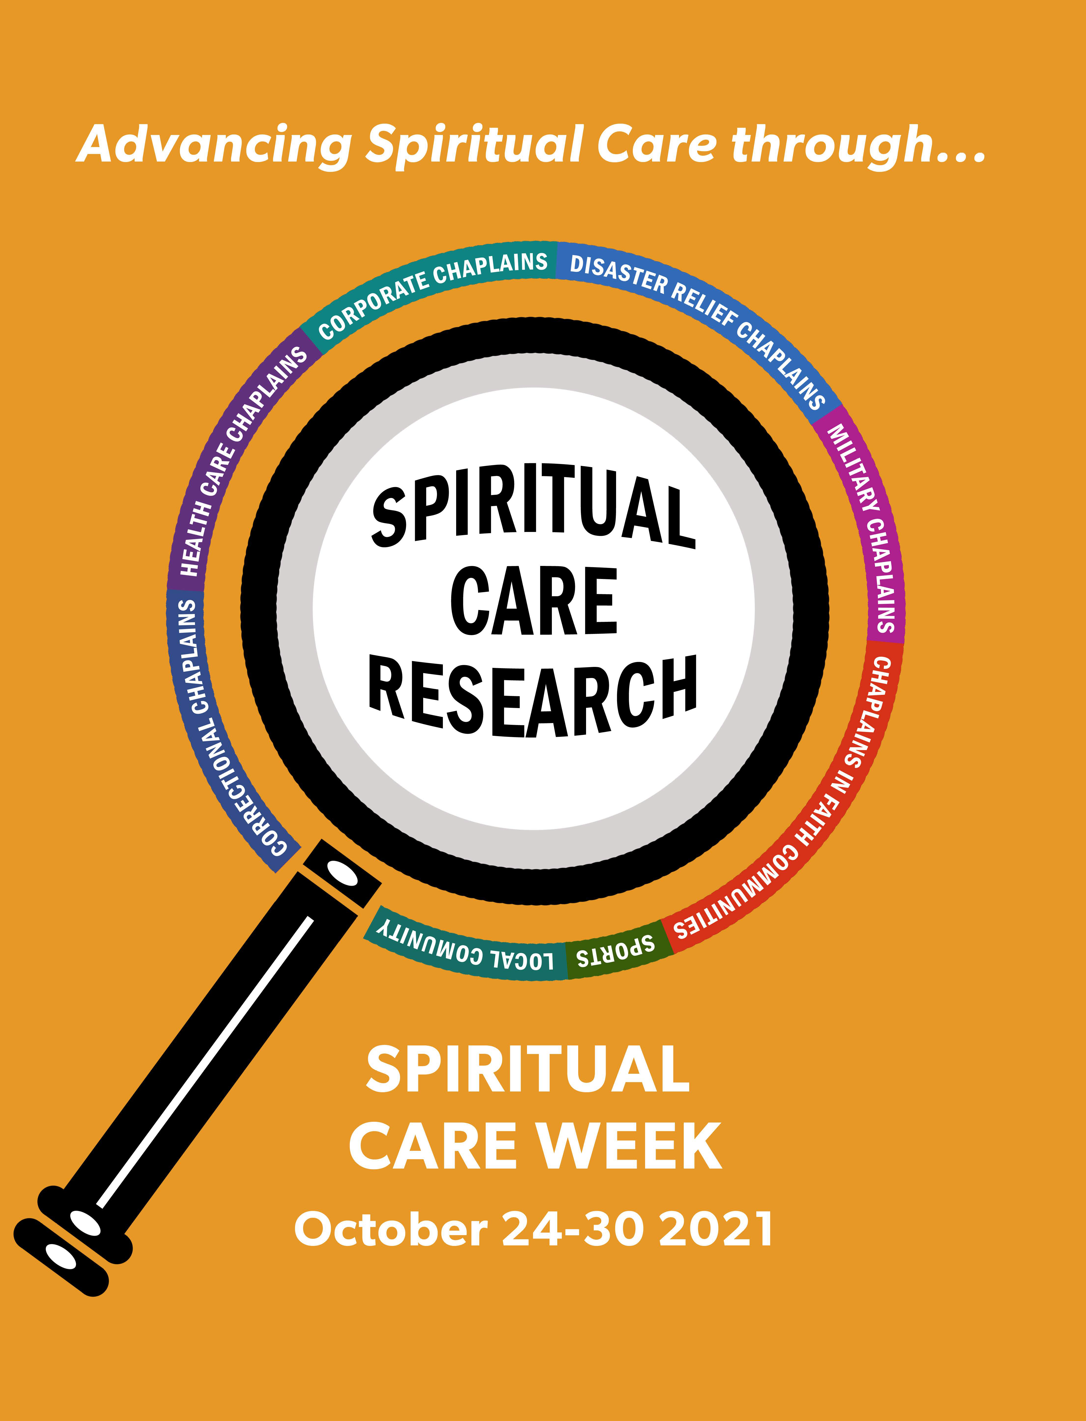
HOW RESEARCH INFORMS MY PRACTICE
Transforming Chaplaincy
Spiritual Care week Webinar
Notes:
Goals of the webinar: 1. Highlight important work done to date – cases and research materials available. 2. no shortage of cases, but shortage of confidence to do the writing and take to next level for publishing. Make a case for more cases especially in gap areas or identified themes. Demystify 2. Engage and provide skills to Groups of researchers to analyze existing cases, comparative.

Slide 2
Presenters
Marilyn J. D. Barnes, MS, MA, MPH, BCC
Chair, Patient Counseling
College of Health Professions
Virginia Commonwealth University
Kristen Schenk, MDiv, MA, BCC
Chaplain, Ann & Robert H. Lurie Children’s Hospital
Chicago, Illinois
Beth Reece, MDiv, BCC
Manager, Spiritual Care
Shirley Ryan AbiltyLab
Chicago, Illinois

Slide 3
Outline and Logistics
Integrating Research into Spiritual Care
Kristen Schenk – Applying Research to Pediatric & Neonatal Chaplaincy
Marilyn Barnes – Advocate Chaplaincy Taxonomy of Spiritual Care
Beth Reece – Mindfulness and Post Traumatic Growth
Panel Discussion: Tips for Chaplains
Q & A: Your questions and suggestions
Please submit questions through the ”Questions” box
Notes:
It’s going to be a little messy. Who wants to be doing this research? How can we connect to each other? We want to facilitate connections between people we are the beginning stages

